Slide 1

Advanced Topics in Networking: Special Topics in Internet of Things
Ambuj Varshney
ambujv@nus.edu.sg, http://ambuj.se
Notes:
++ Thank you for inviting me to give this talk
++ In this talk, I will present a pathway that can enable us to make wireless embedded systems ubiquitous. I will describe my previous research efforts that tackle the critical challenges that limit the growth of wireless embedded systems. These are related to the growing energy asymmetry that exists between sensing, computation and communication blocks on these platforms.
++ Finally, I will conclude my talk by covering the research agenda that I would like to work on as a faculty member.

Slide 2
Lecture 5
Wireless - III, Sensing and Actuation
Notes:
++ Over the past few years, I have designed several backscatter and beyond backscatter systems that precisely overcome these critical challenges that have limited the widespread deployment of backscatter on IoT devices.
++ The research vision that I have pursued and would like to pursue as a faculty member is to enable a massive deployment of IoT devices by bridging the energy asymmetry between sensing, computation and communication blocks by designing novel platforms and communication mechanisms. I am going to describe some of my research contributions next.

Slide 3
Administration
Select papers for class seminar (deadline recess week)
Start to think about projects for the course:
Focus on a good hypothesis/ problem statement
Execution: supporting evidence to go or against the hypothesis
Do not expect significant engineering effort
Course webpage: http://https://weiserlab.github.io/ambuj/cs6204
Notes:
Why do the IoT platforms suffer from this energy challenge? To understand this, we investigate the architecture of the IoT device. We show this architecture in the figure on the slide. It consists of a series of stages that enable us to sense physical phenomena, process and transmit the sensor information through a transceiver such as ZigBee/BLE/LoRa.
This architecture has remained unchanged over the past two decades. We find that during this time, sensors have become exceeding efficient. Today, we find sensors such as an accelerometer or a temperature sensor consumes just a few tens of microwatts of power consumption. However, we find that rest of the architecture components that are shown in red colour remain significantly energy expensive. To understand the reason for this significant energy asymmetry, we look at the following slide.

Slide 4
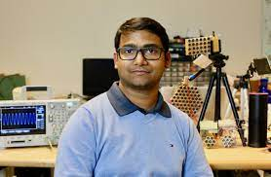
Invited lecture 3: Prof. Nirupam Roy
Assistant Professor at University of Maryland, College Park
Ph.D. from UIUC
Notes:
Why do the IoT platforms suffer from this energy challenge? To understand this, we investigate the architecture of the IoT device. We show this architecture in the figure on the slide. It consists of a series of stages that enable us to sense physical phenomena, process and transmit the sensor information through a transceiver such as ZigBee/BLE/LoRa.
This architecture has remained unchanged over the past two decades. We find that during this time, sensors have become exceeding efficient. Today, we find sensors such as an accelerometer or a temperature sensor consumes just a few tens of microwatts of power consumption. However, we find that rest of the architecture components that are shown in red colour remain significantly energy expensive. To understand the reason for this significant energy asymmetry, we look at the following slide.

Slide 5
Learning Objective for Today’s Lecture
Wireless: Backscatter (RFID) and inductive coupling communication
Understand the basics of actuators, sensors
Case study: Light sensing
Notes:
Why do the IoT platforms suffer from this energy challenge? To understand this, we investigate the architecture of the IoT device. We show this architecture in the figure on the slide. It consists of a series of stages that enable us to sense physical phenomena, process and transmit the sensor information through a transceiver such as ZigBee/BLE/LoRa.
This architecture has remained unchanged over the past two decades. We find that during this time, sensors have become exceeding efficient. Today, we find sensors such as an accelerometer or a temperature sensor consumes just a few tens of microwatts of power consumption. However, we find that rest of the architecture components that are shown in red colour remain significantly energy expensive. To understand the reason for this significant energy asymmetry, we look at the following slide.

Slide 6
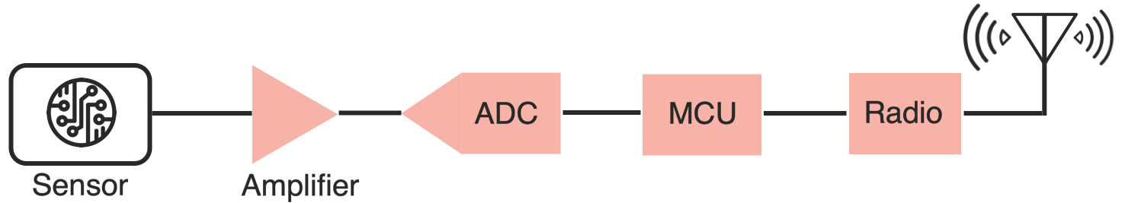
Low-power transmission mechanisms
Carrier signal generation is power consuming
Radios are power consuming compared to sensing/processing
Solution: Do not generate carrier signal
Use existing signal transmitted by a near by device, or already “in-air”
Can also harvest the same signal to power IoT device
Two versions: backscatter and inductive coupling

Slide 7
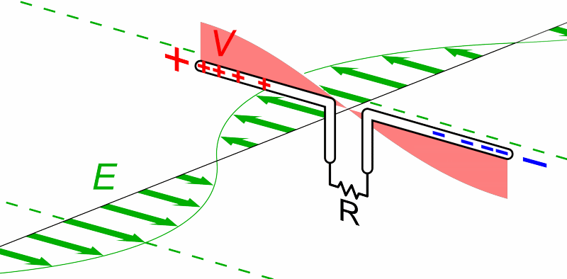
What are Antennas?
High level: They convert between electric and magnetic field
Animation by Chetvorno - Own work, CC0, https://commons.wikimedia.org/w/index.php?curid=40789783
Notes:
Why do the IoT platforms suffer from this energy challenge? To understand this, we investigate the architecture of the IoT device. We show this architecture in the figure on the slide. It consists of a series of stages that enable us to sense physical phenomena, process and transmit the sensor information through a transceiver such as ZigBee/BLE/LoRa.
This architecture has remained unchanged over the past two decades. We find that during this time, sensors have become exceeding efficient. Today, we find sensors such as an accelerometer or a temperature sensor consumes just a few tens of microwatts of power consumption. However, we find that rest of the architecture components that are shown in red colour remain significantly energy expensive. To understand the reason for this significant energy asymmetry, we look at the following slide.

Slide 8
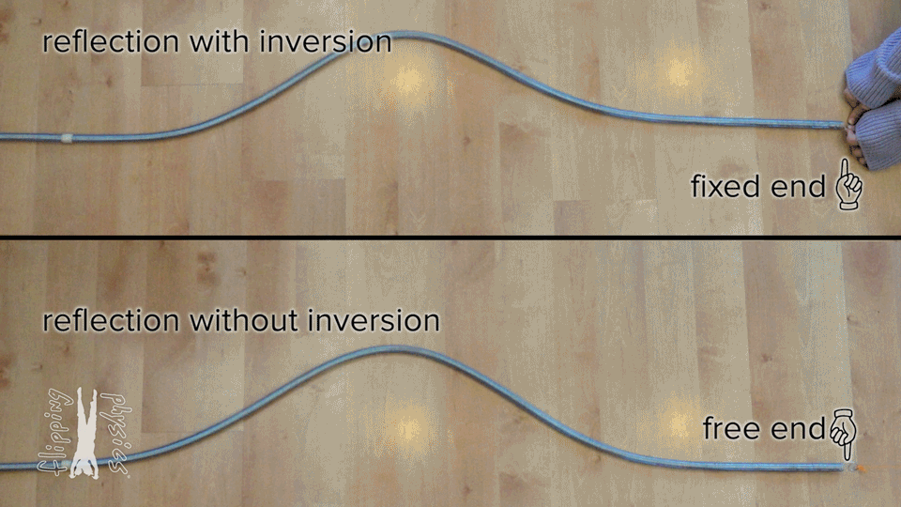
What happens if nothing ‘receives’ the wave?
From: https://www.flippingphysics.com/standing-waves.html

Slide 9
”Fixed end” and “Free end” in transmission
~
Short Circuit = “Free End”
- Reflects wave
~
Open Circuit = “Fixed End”
- Inverts wave
~
Matched Load
- Absorbs wave (no reflection)

Slide 10
Basics of backscatter communication
Vary between absorbing or reflecting signal to modulate data
Wireless transmissions at microwatts of power draw (10000x energy savings)
Frequency bands: 400 MHz, 900 MHz, 2.4 GHz
Ambient RF signal
Antenna
Reflected (backscatter) signal
RF Switch
Modulating Signal (Digital)
Backscatter tag
Reader/ Receiver

Slide 11
Backscatter transmits at (up to) 10000x lower power consumption than conventional radios
Backscatter through absorption or reflection of ambient wireless signals enables wireless transmissions at microwatts of power consumption
Ambient RF signal
Antenna
Reflected (backscatter) signal
RF Switch
Modulating Signal (Digital)
Backscatter tag
Receiver
Notes:
Backscatter communication actually help us overcome this limitation

Slide 12
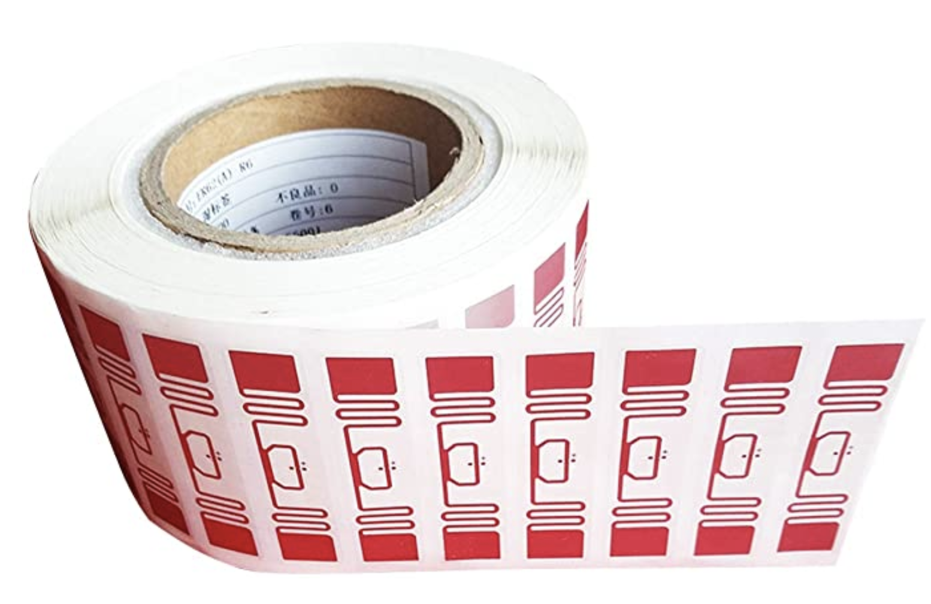
RFID is everywhere nowadays
Fundamental design principle is asymmetry
Extremely simple, cheap tags
Complex readers

Slide 13
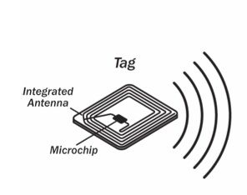
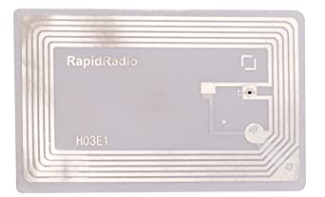
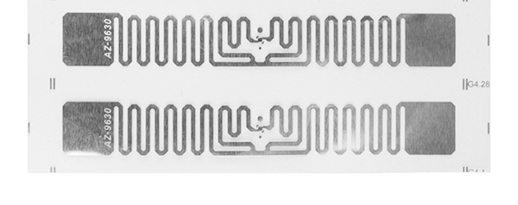
Radio Frequency ID
Cheap, low-power ubiquitous communication
RFID tags on (or in) products
NFC communication to/from smartphone
Requirements
Need to transmit small amount of data (ID)
Need to operate with little or no energy
Most do not have batteries
Short interaction time (fast enough bit rate)
Range can be extremely limited
Meters to centimeters (or millimeters)

Slide 14
Let’s look at RFID standards to get a sense of the numbers
Low Frequency (~300 kHz) — mostly legacy
~10cm read range (inductive coupling)
High Frequency (3~30 MHz; often 13.56 MHz)
Passive: 4~7 m max
Semi-Passive: 10~30 m max
Active: 30+ m
Ultra-High Frequency (300 MHz ~ 3 GHz)
Passive: Up to 12 m (backscatter)
Active: Up to 100 m

Slide 15
RFID challenges
Essentially free communication!
What’s the cost (besides having a higher-capability device)
Difficult to reflect energy when it is already so low
Essentially double the path loss (there and back)
Range is very limited (or transmit power needs to be high)
Meters of range, maximum
Centimeters for inductive coupling
Alternatively, could decouple signal generation from reception

Slide 16
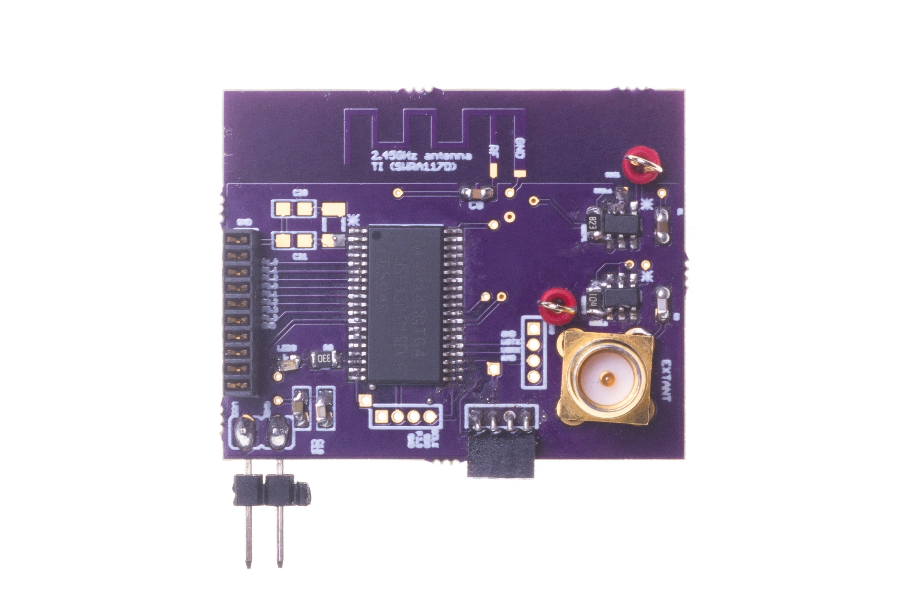
Long range backscatter transmissions using LoRea
LoRea is a long range, low-power, and low-cost backscatter architecture
System Overview
Backscatter Tag Hardware Prototype
(Peak Power of 70 µW)
Varshney et al. ”LoRea: A Backscatter architecture that achieves a long communication range” ACM SENSYS 2017
Notes:
+ Over the past several years, I have designed systems that overcome these critical limitations that have hindered the backscatter systems and have the prevented widespread adoption of the backscatter mechanisms on the Internet of Things devices. One of these systems is LoRea.
+ LoRea was presented at ACM SENSYS, which is a flagship conference in the area of embedded sensor systems. I show the architecture of LoRea on the left-hand figure on the slide. It consists of one or more commodity devices such as a smartphone or Wi-Fi router that provides the necessary carrier signal to support backscatter transmissions, a low-power backscatter tag that I had designed and transmit at a peak power of 70uw, and one or more receiver of backscatter transmissions.
+ The key highlight of LoRea was that it could achieve a significantly larger communication range than existing systems, was designed using off the shelf components and cost (few tens of USDs). Further, the backscatter tag could achieve this capability at orders of magnitude lower energy than commercially available radio transceivers.
+ How did LoRea achieve this capability? We would describe next.

Slide 17
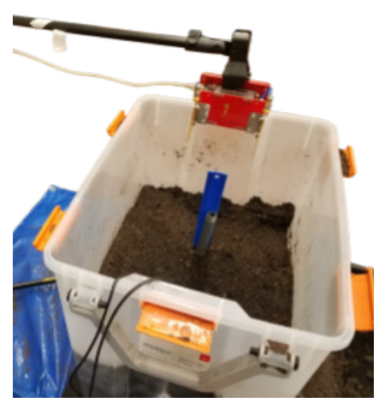
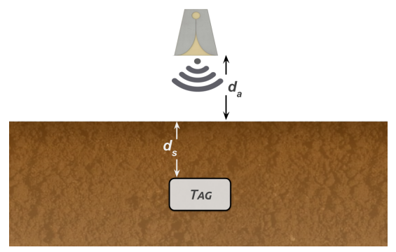
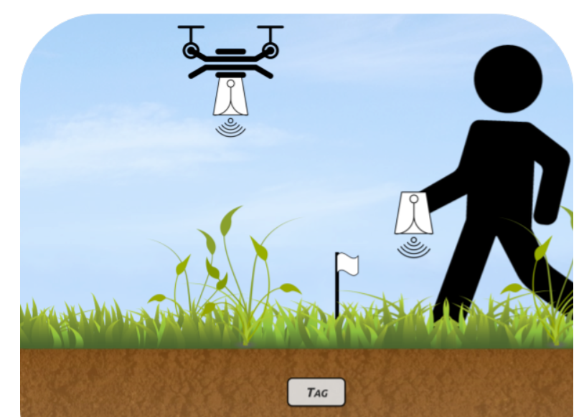
Backscatter as a sensor: soil moisture
Idea: bury backscatter tags in soil
Measure round-trip-time for signal to reflect
T_{s} (time signal travels through ground) changes based on the moisture in the soil
Josephson, Colleen, et al. "Low-cost In-ground Soil Moisture Sensing with Radar Backscatter Tags.“ COMPASS 2021

Slide 18
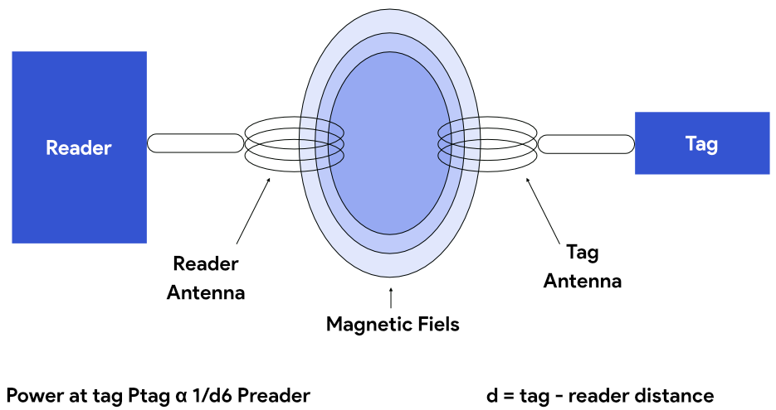
Communication using inductive coupling
A shared magnetic field is created between the two devices
Change in current through one device induces current change through the other
Device can vary load to transmit data
Very low frequency bands (135 KHz, 13.56 MHz)
Transmit through materials including skin
Sensitive to metal

Slide 19
Near Field Communication (NFC)
Inductive Coupling concept (13.56 MHz)
But attached to a powered and capable device (smartphone)
10-20 cm range max (usually <10)
Can act as a tag or as a reader
Allows smartphone to power a tag if needed
Alternatively, smartphone could act like a card and respond to a reader
Two smartphones can communicate without power transfer
Data rate 100-400 kbps!
nRF52840 capable of 100 kbps communication with attached antenna

Slide 20
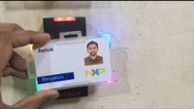
Near Field Communication (NFC)

Slide 21
Learning Objective for Today’s Lecture
Wireless: Backscatter (RFID) and inductive coupling communication
Understand the basics of actuators, sensors
Case study: Light sensing
Notes:
Why do the IoT platforms suffer from this energy challenge? To understand this, we investigate the architecture of the IoT device. We show this architecture in the figure on the slide. It consists of a series of stages that enable us to sense physical phenomena, process and transmit the sensor information through a transceiver such as ZigBee/BLE/LoRa.
This architecture has remained unchanged over the past two decades. We find that during this time, sensors have become exceeding efficient. Today, we find sensors such as an accelerometer or a temperature sensor consumes just a few tens of microwatts of power consumption. However, we find that rest of the architecture components that are shown in red colour remain significantly energy expensive. To understand the reason for this significant energy asymmetry, we look at the following slide.

Slide 22
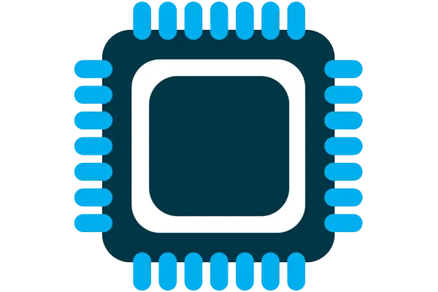



Four components of internet of things device
Computation and Storage
Sensing and Actuation
Power
Wireless Connectivity
Notes:
First, we look at the computational elements, and these consist of a microcontroller or an FPGA. Today, we find that these computational elements consume at least one order of magnitude higher power consumption when compared to the commonly used sensors.
However, we also find that microcontrollers are increasingly becoming energy efficient. We investigate a typical microcontroller that has been used in sensor platforms over the past two decades. We find that energy efficiency has improved by almost two orders of magnitude. Some of the present-generation microcontrollers, such as Ambiq Apollo4 consume just 3 uA/MHz than 330 uA for MSP430 used on platforms such as TelOS B.
If the trend continues, we can expect the microcontrollers to catch up with the sensors and become energy-efficient. This significant improvement is that the digital components are increasing becoming efficient as they follow moore’s law.

Slide 23
Four components of internet of things device
Computation and Storage
Sensing and Actuation
Power
Wireless Connectivity
Notes:
First, we look at the computational elements, and these consist of a microcontroller or an FPGA. Today, we find that these computational elements consume at least one order of magnitude higher power consumption when compared to the commonly used sensors.
However, we also find that microcontrollers are increasingly becoming energy efficient. We investigate a typical microcontroller that has been used in sensor platforms over the past two decades. We find that energy efficiency has improved by almost two orders of magnitude. Some of the present-generation microcontrollers, such as Ambiq Apollo4 consume just 3 uA/MHz than 330 uA for MSP430 used on platforms such as TelOS B.
If the trend continues, we can expect the microcontrollers to catch up with the sensors and become energy-efficient. This significant improvement is that the digital components are increasing becoming efficient as they follow moore’s law.

Slide 24
Definitions: What are sensors?
Sensor is a device that measures a physical phenomenon
Temperature sensor
Humidity sensor
Acoustic sensor
Image sensor
…….
Sensors have become numerous, very low-power, and highly capable
Notes:
First, we look at the computational elements, and these consist of a microcontroller or an FPGA. Today, we find that these computational elements consume at least one order of magnitude higher power consumption when compared to the commonly used sensors.
However, we also find that microcontrollers are increasingly becoming energy efficient. We investigate a typical microcontroller that has been used in sensor platforms over the past two decades. We find that energy efficiency has improved by almost two orders of magnitude. Some of the present-generation microcontrollers, such as Ambiq Apollo4 consume just 3 uA/MHz than 330 uA for MSP430 used on platforms such as TelOS B.
If the trend continues, we can expect the microcontrollers to catch up with the sensors and become energy-efficient. This significant improvement is that the digital components are increasing becoming efficient as they follow moore’s law.

Slide 25
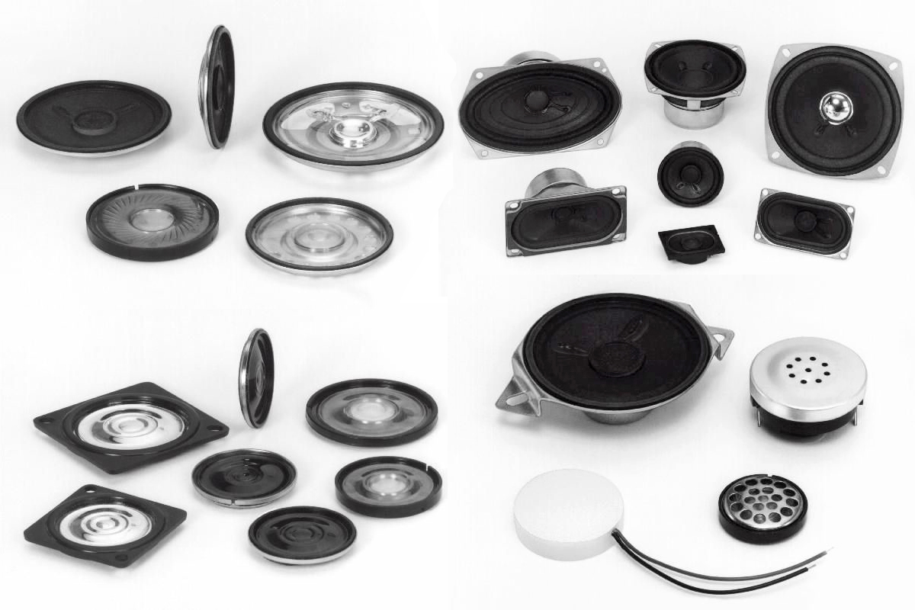
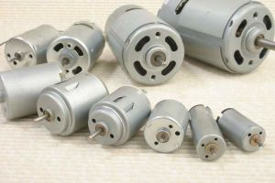
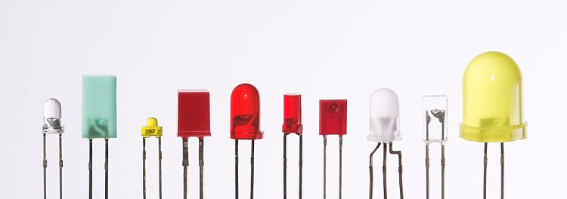
Definitions: What are actuator?
Actuator is a device that modifies a physical quantity
Light/LED
Motor
Speaker
…….
Notes:
First, we look at the computational elements, and these consist of a microcontroller or an FPGA. Today, we find that these computational elements consume at least one order of magnitude higher power consumption when compared to the commonly used sensors.
However, we also find that microcontrollers are increasingly becoming energy efficient. We investigate a typical microcontroller that has been used in sensor platforms over the past two decades. We find that energy efficiency has improved by almost two orders of magnitude. Some of the present-generation microcontrollers, such as Ambiq Apollo4 consume just 3 uA/MHz than 330 uA for MSP430 used on platforms such as TelOS B.
If the trend continues, we can expect the microcontrollers to catch up with the sensors and become energy-efficient. This significant improvement is that the digital components are increasing becoming efficient as they follow moore’s law.

Slide 26

Actuation is energy expensive (wrt sensing)
Notes:
First, we look at the computational elements, and these consist of a microcontroller or an FPGA. Today, we find that these computational elements consume at least one order of magnitude higher power consumption when compared to the commonly used sensors.
However, we also find that microcontrollers are increasingly becoming energy efficient. We investigate a typical microcontroller that has been used in sensor platforms over the past two decades. We find that energy efficiency has improved by almost two orders of magnitude. Some of the present-generation microcontrollers, such as Ambiq Apollo4 consume just 3 uA/MHz than 330 uA for MSP430 used on platforms such as TelOS B.
If the trend continues, we can expect the microcontrollers to catch up with the sensors and become energy-efficient. This significant improvement is that the digital components are increasing becoming efficient as they follow moore’s law.

Slide 27
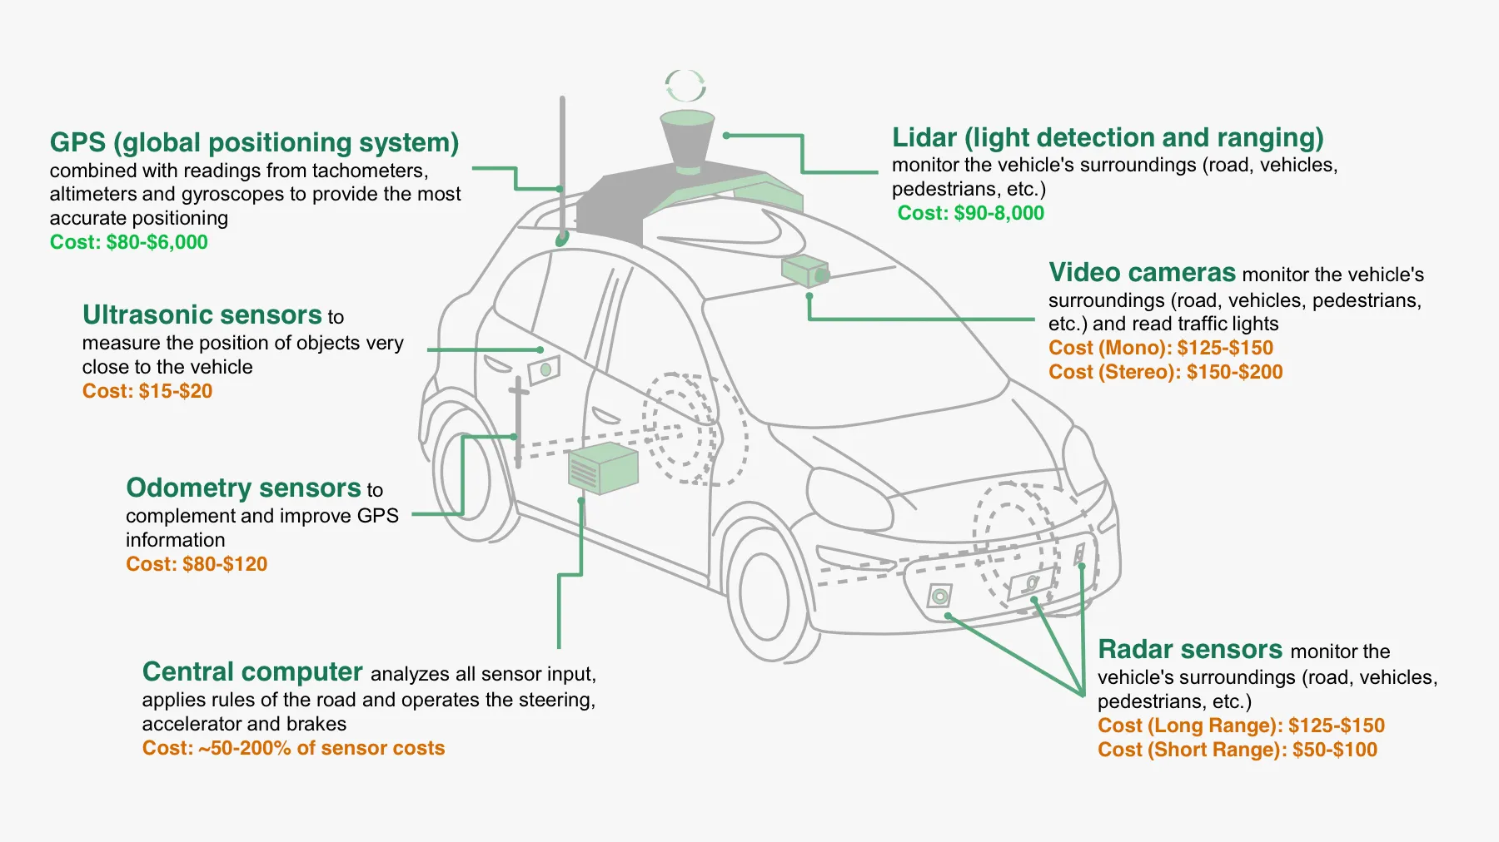
Cars are all software and sensors
Notes:
First, we look at the computational elements, and these consist of a microcontroller or an FPGA. Today, we find that these computational elements consume at least one order of magnitude higher power consumption when compared to the commonly used sensors.
However, we also find that microcontrollers are increasingly becoming energy efficient. We investigate a typical microcontroller that has been used in sensor platforms over the past two decades. We find that energy efficiency has improved by almost two orders of magnitude. Some of the present-generation microcontrollers, such as Ambiq Apollo4 consume just 3 uA/MHz than 330 uA for MSP430 used on platforms such as TelOS B.
If the trend continues, we can expect the microcontrollers to catch up with the sensors and become energy-efficient. This significant improvement is that the digital components are increasing becoming efficient as they follow moore’s law.

Slide 28
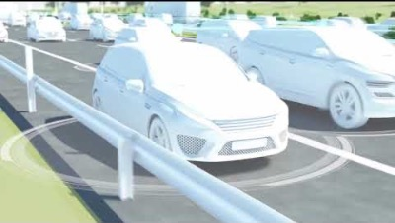
Cars are all software and sensors
Notes:
First, we look at the computational elements, and these consist of a microcontroller or an FPGA. Today, we find that these computational elements consume at least one order of magnitude higher power consumption when compared to the commonly used sensors.
However, we also find that microcontrollers are increasingly becoming energy efficient. We investigate a typical microcontroller that has been used in sensor platforms over the past two decades. We find that energy efficiency has improved by almost two orders of magnitude. Some of the present-generation microcontrollers, such as Ambiq Apollo4 consume just 3 uA/MHz than 330 uA for MSP430 used on platforms such as TelOS B.
If the trend continues, we can expect the microcontrollers to catch up with the sensors and become energy-efficient. This significant improvement is that the digital components are increasing becoming efficient as they follow moore’s law.

Slide 29
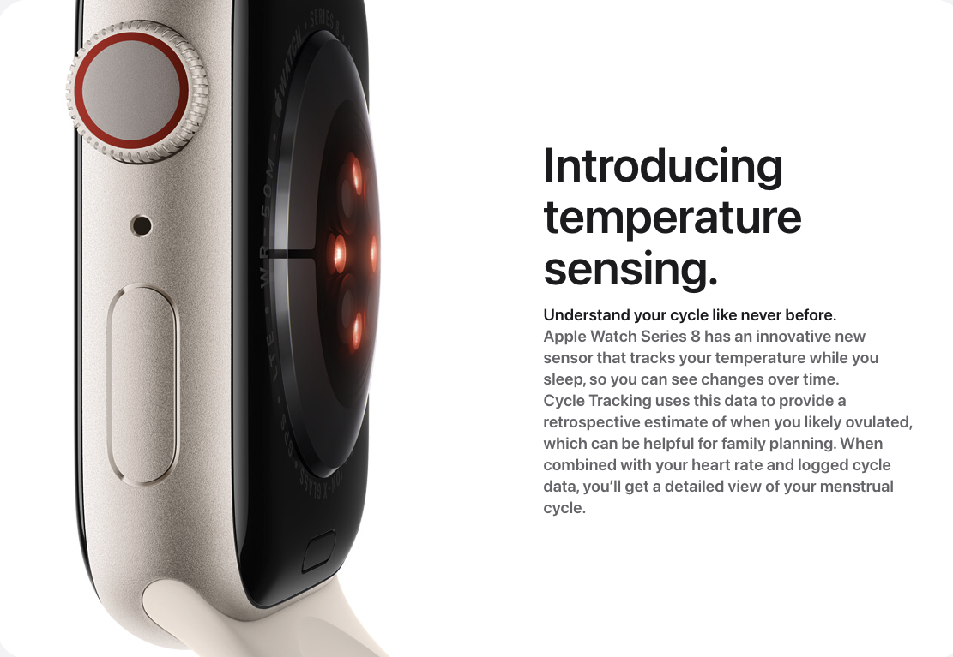
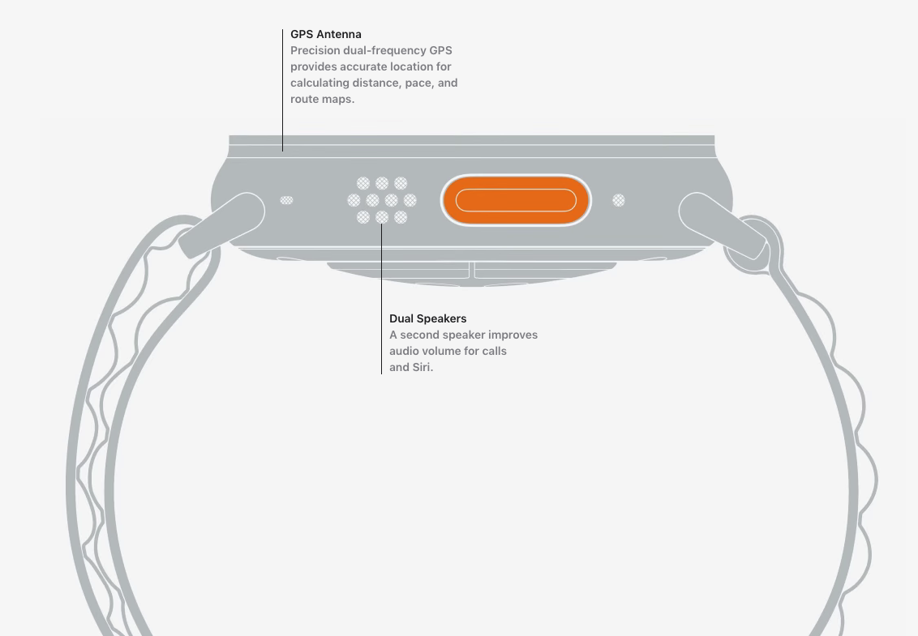
Sensors and actuators are an integral part of most consumer electronic devices
Essential part of almost all consumer electronic devices
They are an Interface of electronic devices with the physical world
Courtesy: Apple
Notes:
First, we look at the computational elements, and these consist of a microcontroller or an FPGA. Today, we find that these computational elements consume at least one order of magnitude higher power consumption when compared to the commonly used sensors.
However, we also find that microcontrollers are increasingly becoming energy efficient. We investigate a typical microcontroller that has been used in sensor platforms over the past two decades. We find that energy efficiency has improved by almost two orders of magnitude. Some of the present-generation microcontrollers, such as Ambiq Apollo4 consume just 3 uA/MHz than 330 uA for MSP430 used on platforms such as TelOS B.
If the trend continues, we can expect the microcontrollers to catch up with the sensors and become energy-efficient. This significant improvement is that the digital components are increasing becoming efficient as they follow moore’s law.

Slide 30
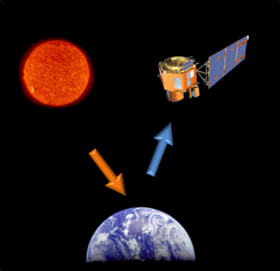
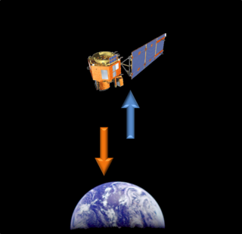
Different forms of sensing: Active vs Passive
Passive Sensing
Active Sensing

Slide 31
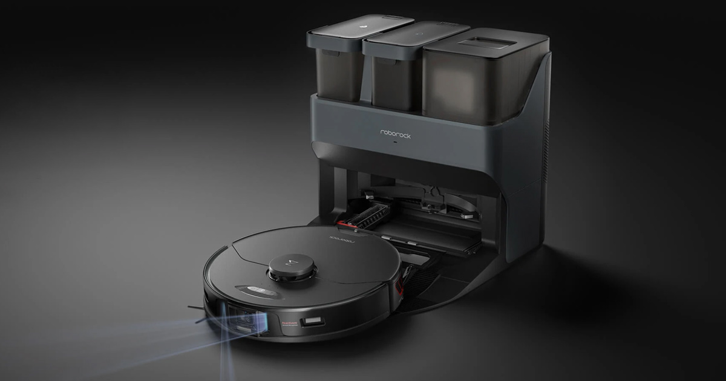
Different forms of sensing: Active vs Passive
We usually focus on passive sensing
Cheaper and lower energy costs!
Active sensing examples
Flash photography
Ultrasonic distance sensing
Lidar and Radar

Slide 32
Sensors transform a physical phenomenon into an electric signal
Microcontrollers can interact with analog or digital signals
Generating an analog signal proportional to physical phenomenon allows the physical quantity to be sensed by a microcontroller
How do we generate an electrical signal?
Ohm’s Law: V = I * R (Voltage = Current * Resistance)
Vary one of these three (according to physical phenomenon) and an analog signal is created corresponding to the physical phenomenon

Slide 33
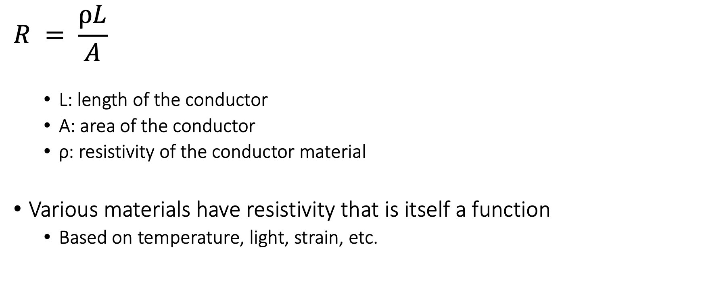
One of the major sensor type: Resistive
$$R = \frac{ρL}{A}$$
L: length of the conductor
A: area of the conductor
ρ: resistivity of the conductor material
Various materials have resistivity that is itself a function
Based on temperature, light, strain, etc.

Slide 34
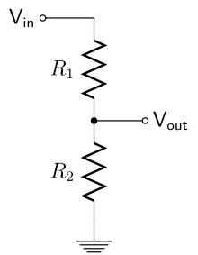
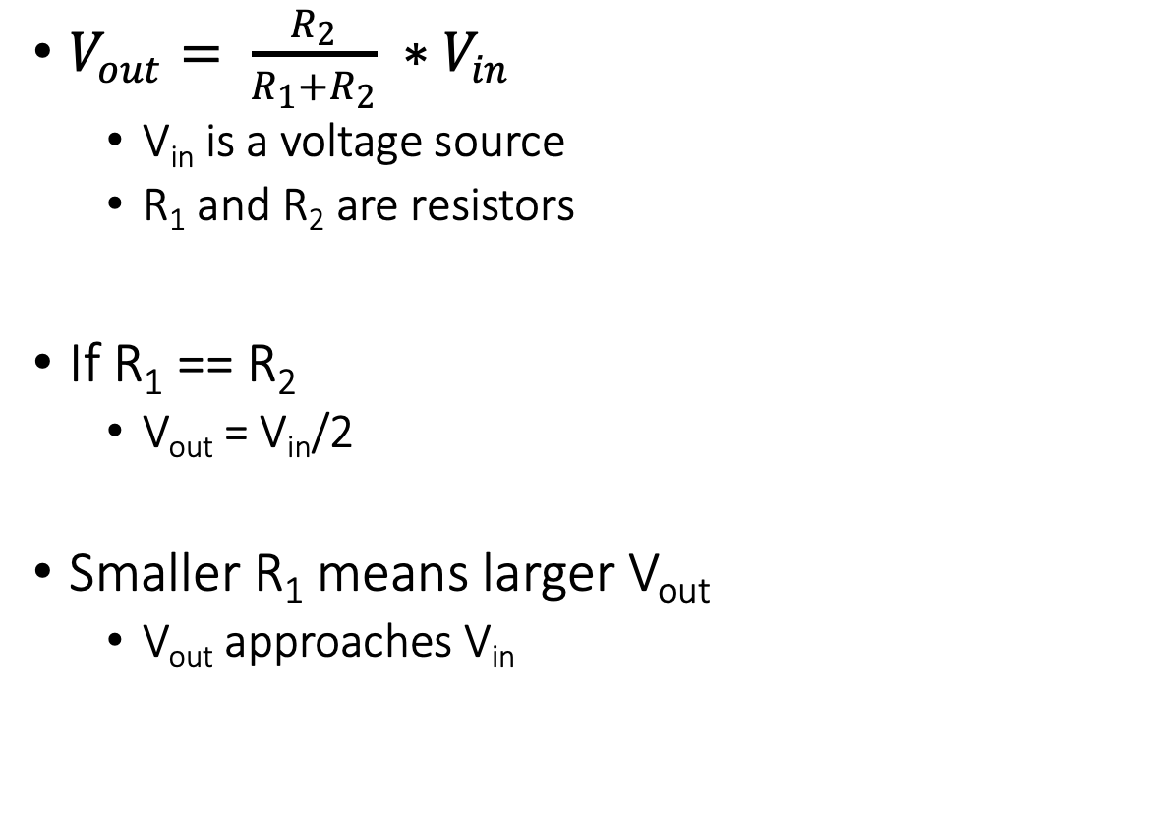
Electronics basics: Voltage dividers
$V_{out}= \frac{R_{2}}{R_{1}+R_{2}} ∗V_{in}$
V_{in} is a voltage source
R₁ and R₂ are resistors
If R₁ == R₂
V_{out} = V_{in}/2
Smaller R₁ means larger V_{out}
V_{out} approaches V_{in}

Slide 35
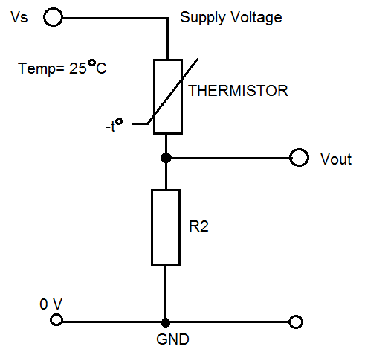
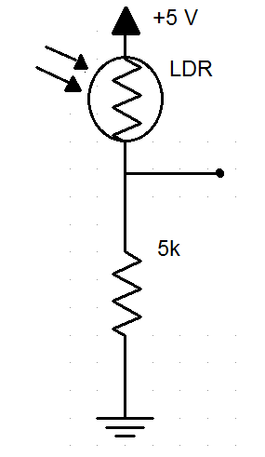
How do we measure a resistive sensor?
Place in series with another resistor
Between VCC and ground
Measure voltage between the two relative to ground
Forms a “voltage divider”

Slide 36
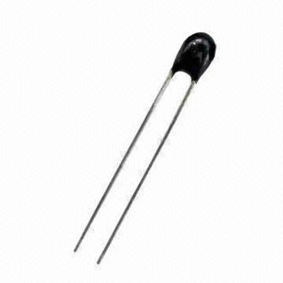
Example: Resistive temperature sensors
Thermistor varies resistance based on temperature
Set up as a voltage divider to measure
Advantages: cheap and easy to use
Disadvantages: non-linear transfer function

Slide 37
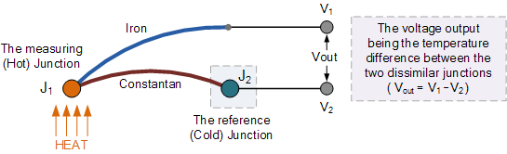
Other temperature sensor: Thermocouple
Thermocouple generates a voltage based on temperature
Can be used to harvest energy to run system

Slide 38
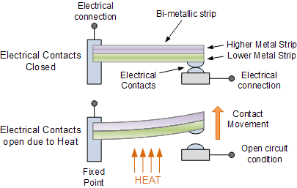
Other temperature sensor: Thermostat
Heat bends a strip of two different metals
Switches circuit on/off based on the temperature

Slide 39

Sensors in factories are becoming battery-free
Notes:
First, we look at the computational elements, and these consist of a microcontroller or an FPGA. Today, we find that these computational elements consume at least one order of magnitude higher power consumption when compared to the commonly used sensors.
However, we also find that microcontrollers are increasingly becoming energy efficient. We investigate a typical microcontroller that has been used in sensor platforms over the past two decades. We find that energy efficiency has improved by almost two orders of magnitude. Some of the present-generation microcontrollers, such as Ambiq Apollo4 consume just 3 uA/MHz than 330 uA for MSP430 used on platforms such as TelOS B.
If the trend continues, we can expect the microcontrollers to catch up with the sensors and become energy-efficient. This significant improvement is that the digital components are increasing becoming efficient as they follow moore’s law.

Slide 40
Once you get a sensor signal, what do you do with this signal?
Need to understand the transfer function between voltage and the sensed quantity (physical phenomenon)
Examples for an accelerometer: senses acceleration
Digital components only understand digital signals
Convert the analog signal into digital

Slide 41
Analog signals are converted to digital signals
Microcontrollers only process digital signals
Analog signals are transformed into digital signals
Most microcontrollers have an analog to digital converter built-in
Can be power consuming operation
Often analog signals need amplification

Slide 42
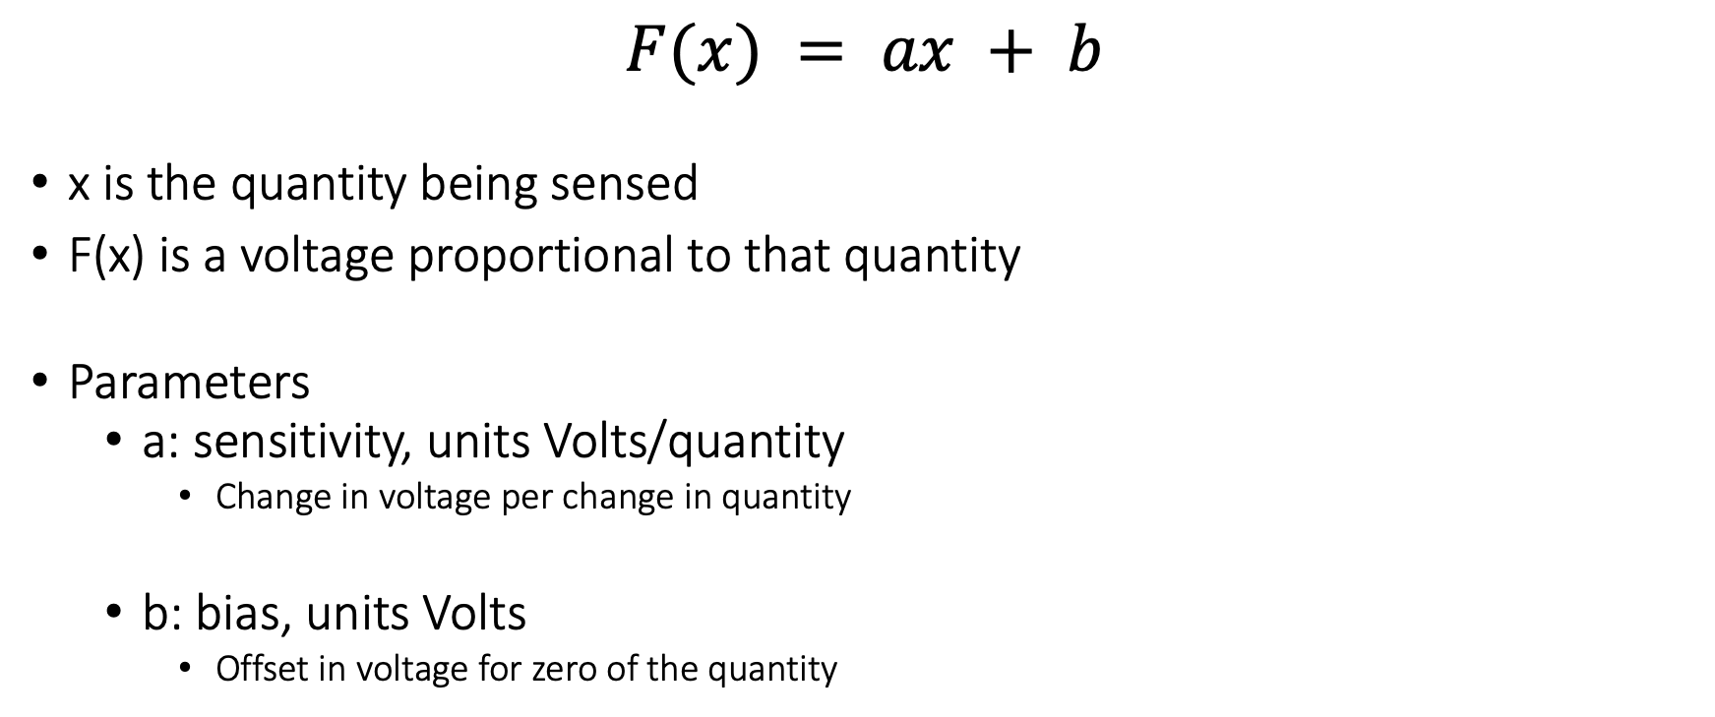
Affine sensor model (for linear sensors)
$$F(x) = ax + b$$
x is the quantity being sensed
F(x) is a voltage proportional to that quantity
Parameters
a: sensitivity, units Volts/quantity
Change in voltage per change in quantity
b: bias, units Volts
Offset in voltage for zero of the quantity

Slide 43
Motion sensing: Inertial measurement unit (IMU)
IMUs (a.k.a 9 degree-of-freedom, 9DOF) are used for tracking motion of a device
Acceleration (X, Y, Z axes)
Rotation (X, Y, Z axes)
Magnetism (X, Y, Z axes)
Sometimes 6DOF with Acceleration + one of the others
Intelligent sensing: combines multiple sensors, ADCs, and computation with a wired interface
9 analog inputs would otherwise be too many
Can be used to track motion, determine transportation method
Smartphones, Robotics, etc.

Slide 44
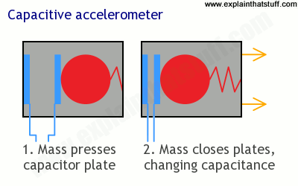
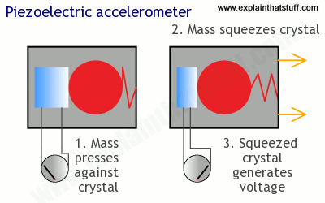
Motion sensing: acceleration
Goal: create a voltage that changes based on force

Slide 45
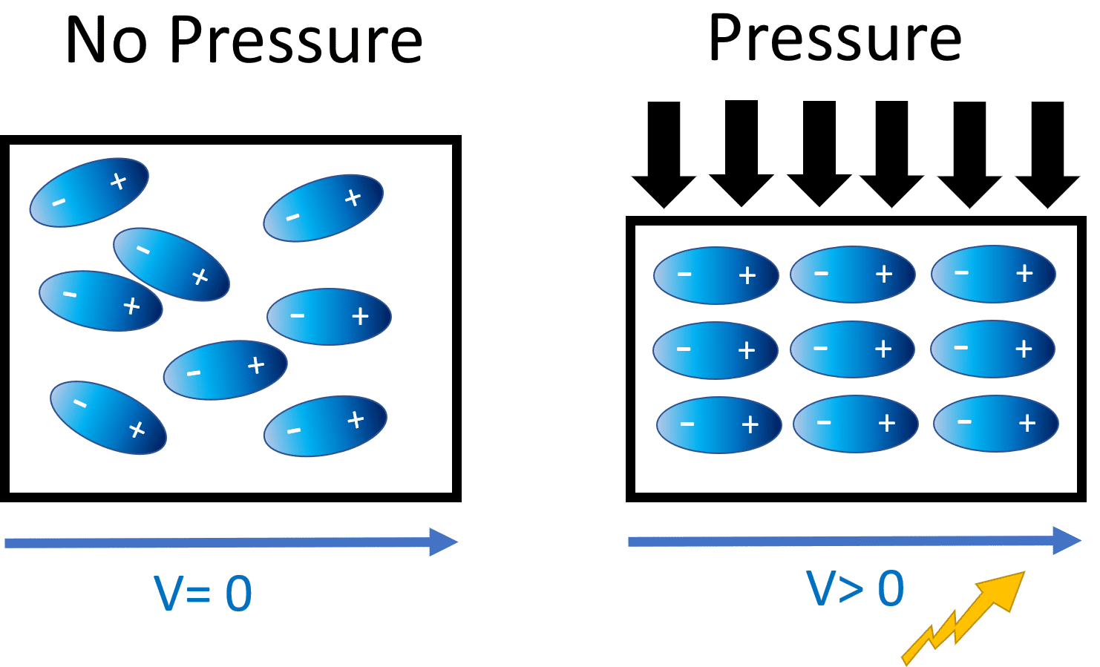
Generating voltage via piezoelectric effect
Compression of the material generates a voltage
Various sources of compression:
Air Pressure
Acceleration
Strain

Slide 46
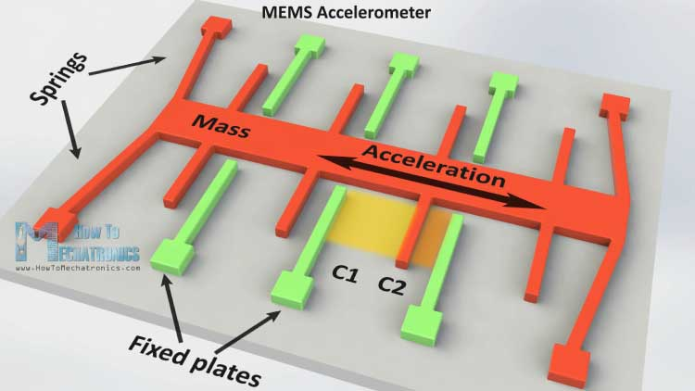
Motion sensing: Microelectromechanical Systems (MEMS)
Same concept, but within an IC and 1 to 100 micrometers in size

Slide 47
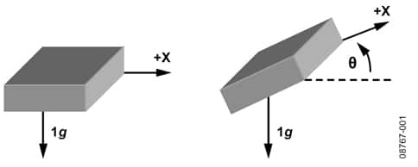
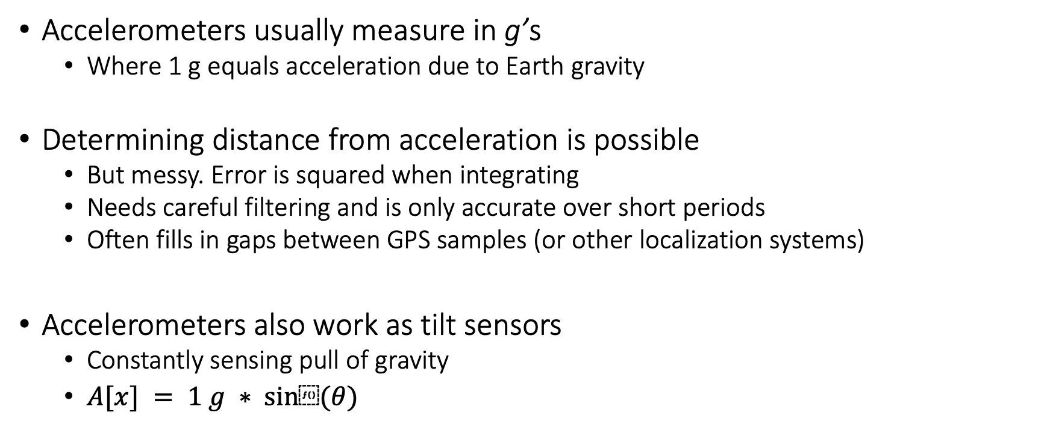
Motion sensing: accelerometers
Accelerometers usually measure in g’s
Where 1 g equals acceleration due to Earth gravity
Determining distance from acceleration is possible
But messy. Error is squared when integrating
Needs careful filtering and is only accurate over short periods
Often fills in gaps between GPS samples (or other localization systems)
Accelerometers also work as tilt sensors
Constantly sensing pull of gravity
$A[x] = 1 g ∗ sin⁡(θ)$

Slide 48
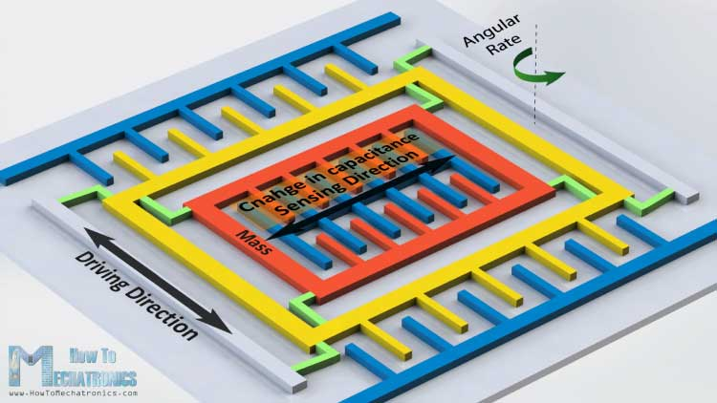
Motion sensing: Gyroscopes
Measures angular velocity
<10 rotations per second
Usually, we want angle instead of rotation speed
Integrate signal to determine current angle
Combine noise and DC bias with integration and you get a continuously accumulating error: drift

Slide 49

Motion sensors are an integral part of factories
Notes:
First, we look at the computational elements, and these consist of a microcontroller or an FPGA. Today, we find that these computational elements consume at least one order of magnitude higher power consumption when compared to the commonly used sensors.
However, we also find that microcontrollers are increasingly becoming energy efficient. We investigate a typical microcontroller that has been used in sensor platforms over the past two decades. We find that energy efficiency has improved by almost two orders of magnitude. Some of the present-generation microcontrollers, such as Ambiq Apollo4 consume just 3 uA/MHz than 330 uA for MSP430 used on platforms such as TelOS B.
If the trend continues, we can expect the microcontrollers to catch up with the sensors and become energy-efficient. This significant improvement is that the digital components are increasing becoming efficient as they follow moore’s law.

Slide 50
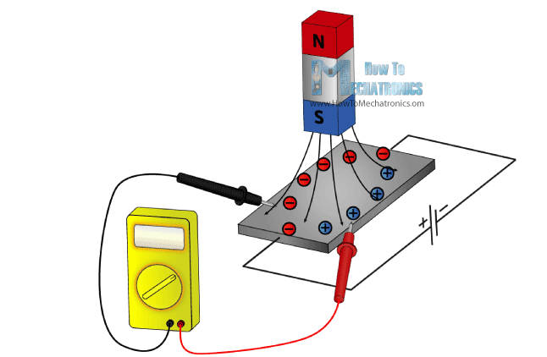
Other sensors: magnetic field (magnetometer)
Measures the magnetic field
Usually used in devices as a compass
Detect Earth’s magnetic field orientation
Satellites can use magnetometers for localization

Slide 51
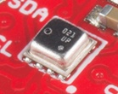
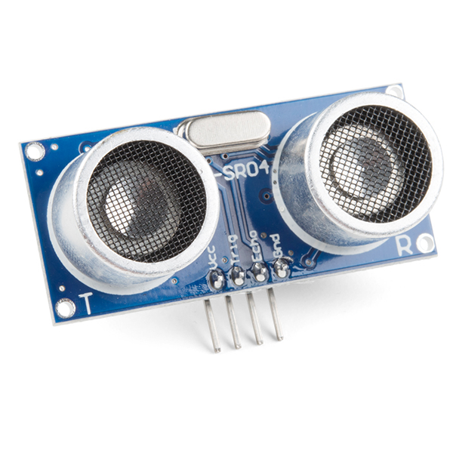
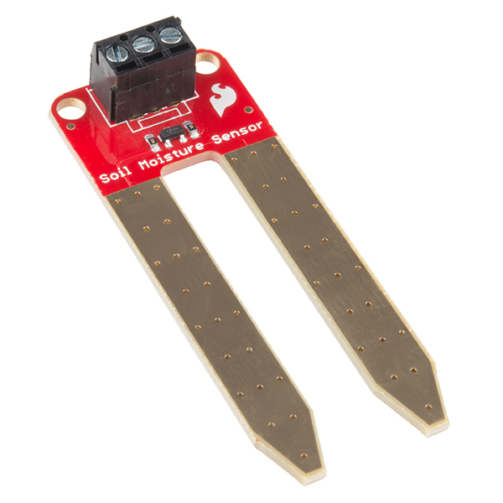
Even more types of sensors
Environment: Pressure, Humidity, Air Velocity, Air Quality
Distance: Ultrasonic, Lidar, or Radar
Biometric: Pulse Oximeter, Heart Rate
Agricultural: Soil moisture

Slide 52
Learning Objective for Today’s Lecture
Wireless: Backscatter and inductive coupling communication
Understand the basics of actuators, sensors
Case study: Light sensing
Notes:
Why do the IoT platforms suffer from this energy challenge? To understand this, we investigate the architecture of the IoT device. We show this architecture in the figure on the slide. It consists of a series of stages that enable us to sense physical phenomena, process and transmit the sensor information through a transceiver such as ZigBee/BLE/LoRa.
This architecture has remained unchanged over the past two decades. We find that during this time, sensors have become exceeding efficient. Today, we find sensors such as an accelerometer or a temperature sensor consumes just a few tens of microwatts of power consumption. However, we find that rest of the architecture components that are shown in red colour remain significantly energy expensive. To understand the reason for this significant energy asymmetry, we look at the following slide.

Slide 53
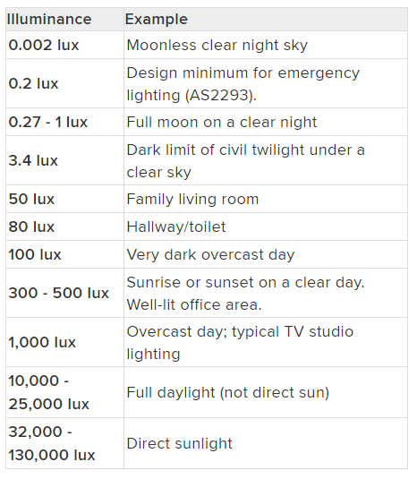
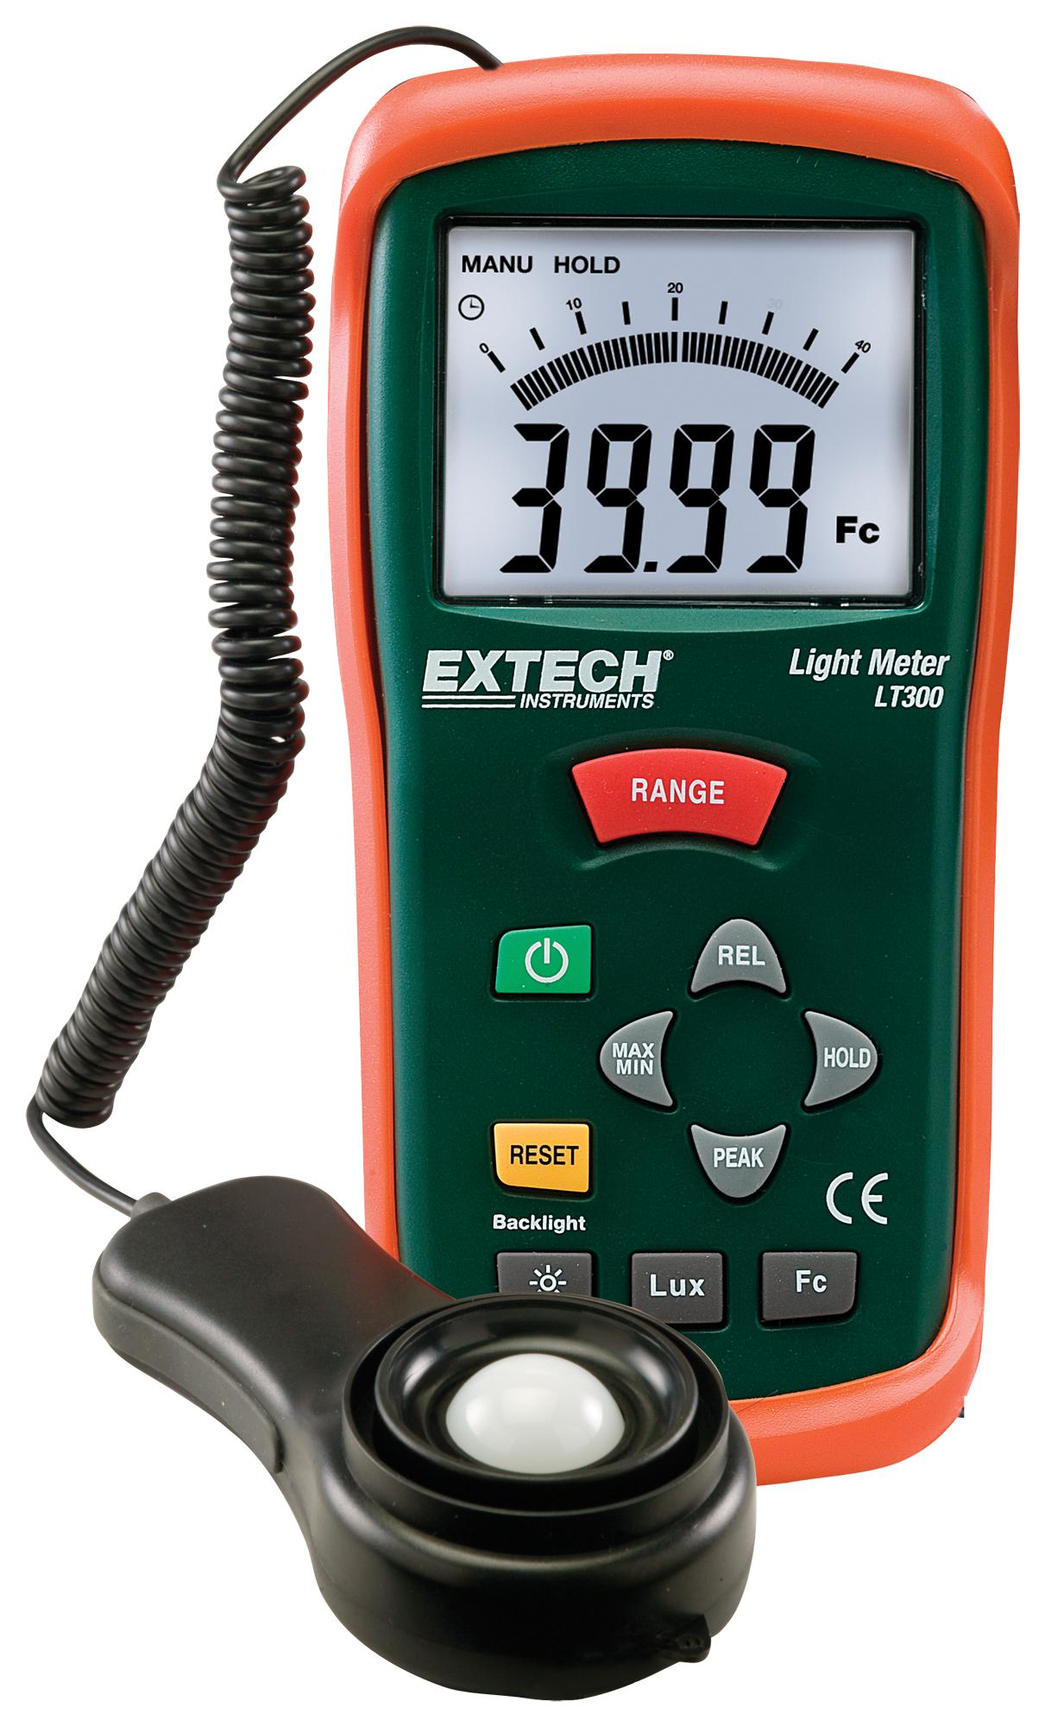
How do we measure light?
Lux: unit of illuminance

Slide 54
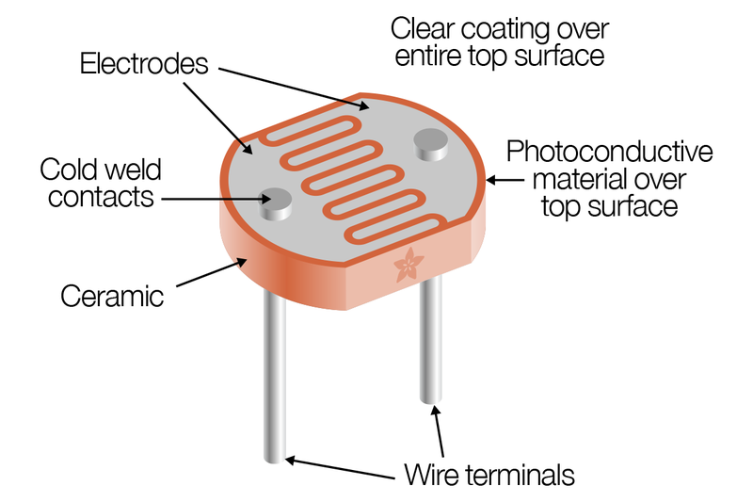
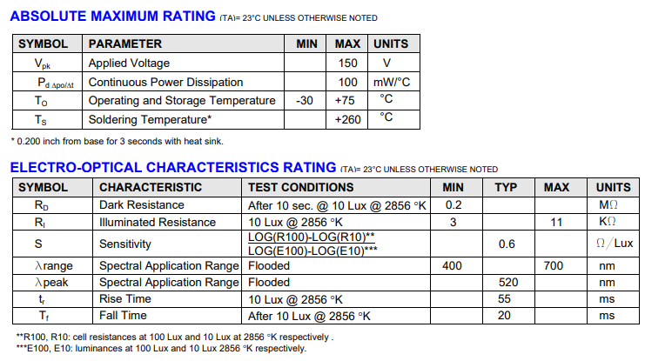
Light sensing: Resistive (Photocell)
Photocell changes resistance with light (non-linear)
10 kΩ when dark
1 kΩ when light

Slide 55
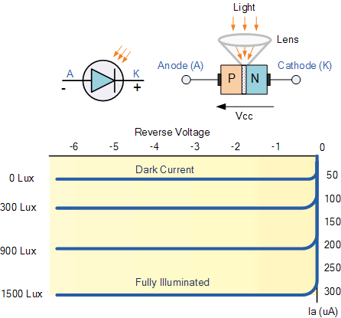
Light sensing: Photodiodes
Most common type of light sensing mechanism
When voltage is applied in reverse to an ideal diode, no current flows
But some small amount of current leaks for real-world photo diodes
Proportional to light levels!

Slide 56

Light sensing: LEDs?
LEDs can be used as (crappy) photodiodes as well!
Apply reverse voltage
Read in leak current as voltage across a resistor using ADC

Slide 57

Light sensing mechanisms are energy expensive
Energy expensive light sensing mechanism (mWs)
Photodiodes coupled with an amplifier
Analog to digital converters (ADCs)
Computational blocks – MCU/FPGA

Slide 58

Battery-free Visible Light Sensing

Slide 59

Visible Light Marker Schematic
Light sensing
Digitisation
Communication without processing

Slide 60

Solar cell for passive Visible Light Sensing
Solar cells passive requires no external power
Eliminates energy expensive photodiodes and amplifiers
Enables energy harvesting to support battery-free operations
Operate under diverse light conditions (100 lux to 80k lux )
Reduces energy consumed for sensing to zero!

Slide 61
Selecting solar cell for visible light sensing
Cast shadow on different types solar cell
Indoor light level : 200 lx
Shadow causes significant change in SNR for all solar cells
Significant change in SNR in presence of shadow

Slide 62
Digitizing at µWs of power
Multibit Analog to digital converters (ADC) are energy expensive
Periodic polling to detect shadow events
Many sensing applications do not require such high resolution
Thresholding circuit acts like 1-bit ADC
No polling required, responds to shadow event
Peak power consumption: 0.5 µW

Slide 63

Power consumption
Module | Power consumption
Solar cell | 0
Thresholding circuit | 0.5 $μW$
Scatterlight (100 kHz – 1 MHz) | 19.5 $μW$ – 120 $μW$

Slide 64






Application: Gesture recognition

Slide 65

Demo – Gesture recognition
Shift ambient FM station to transmit shadow event

Slide 66



Passive Infrared (PIR) sensor
Detect movement in the environment
By detecting change in IR levels
Often come with plastic lens cover to improve field of view and range

Slide 67


PIR sensors come in digital and analog forms
Digital includes a preconfigured comparator

Slide 68
No reading due next week
Passive PIR sensor paper (not to be submitted):
Notes:
Backscatter communication actually help us overcome this limitation

Slide 69
CS 6204 - Advanced Topics in Networking
Ambuj Varshney
ambujv@nus.edu.sg
http://ambuj.se
Notes:
Good morning/afternoon everyone. Thank you for inviting me for giving this talk.
In this talk, I will describe my effort to design ubiquitous Internet of Things systems.
In the end of the talk: I will cover some of the future research directions that I would like to address as a faculty member.

